Slide 1


RESUMES
AND INTERVIEWING

Slide 2

RESUME
A brief summary of professional, education and personal accomplishments that is
  1-2 pages long (typically 1 page)
  Simple, easy to read
  Do not use "I" or "me"
Notes:
Fill entire page...do not do 2 pages unless you can fill 2 pages

Slide 3

RESUME TYPES
Chronological
  Short history of education and work experience in reverse chronological order (most recent education and job experience)
  Includes the following sections:
    Contact Info
    Objective
    Education
    Work Experience
    Professional memberships and affiliations
    Licenses and certifications
    Awards and honors

Slide 4
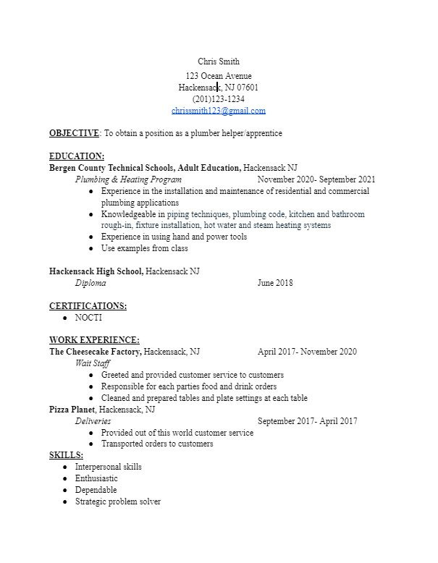
RESUME TYPES
Entry-Level Resume
  For those that are new to the workforce or do not have detailed job experience
  Shorter and skilled focused
  Most entry-level jobs come with the expectation that the depth of experience and work history is lower

Slide 5
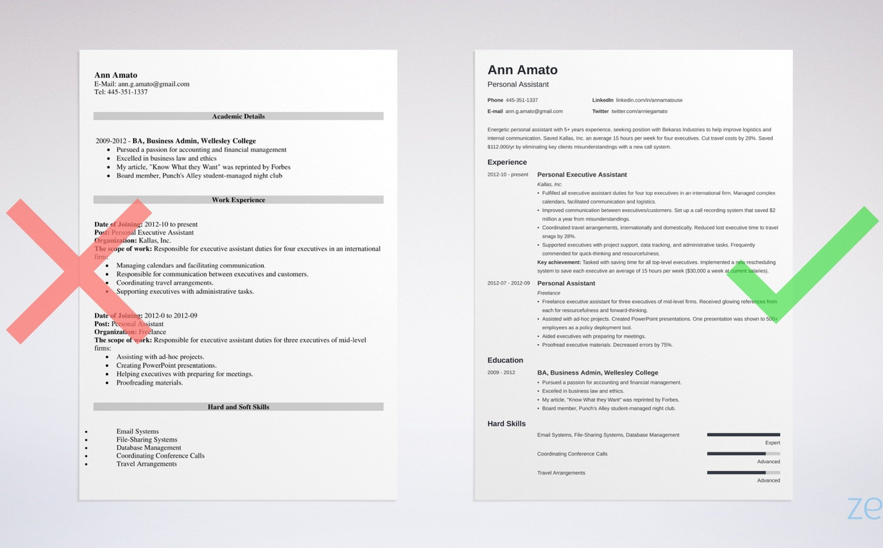
FORMATING
A first glance of a resume can say a lot about your professionalism.
Things to keep in mind:
  Opt for bullet points
  Balanced white space
  Two-front limit (ex. 1 for heading, 1 for rest of resume)
  Limit font style (italics and bolding should be used in small doses)

Slide 6


RESUME DON'TS
https://www.youtube.com/watch?v=uLg3q44vfWI

Slide 7
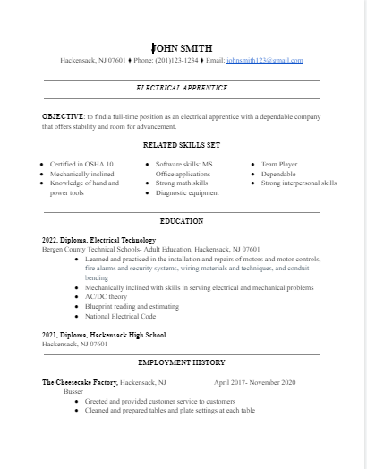
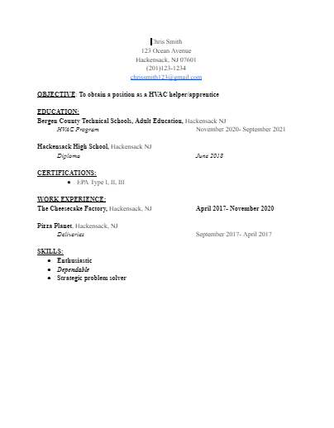
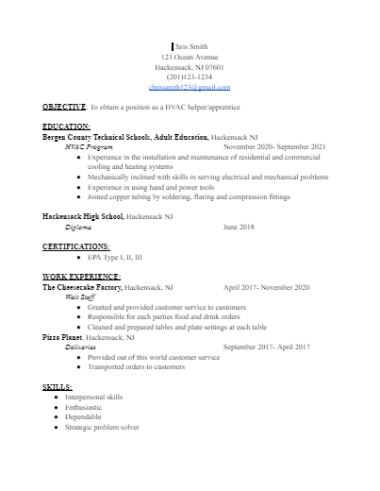



Slide 8
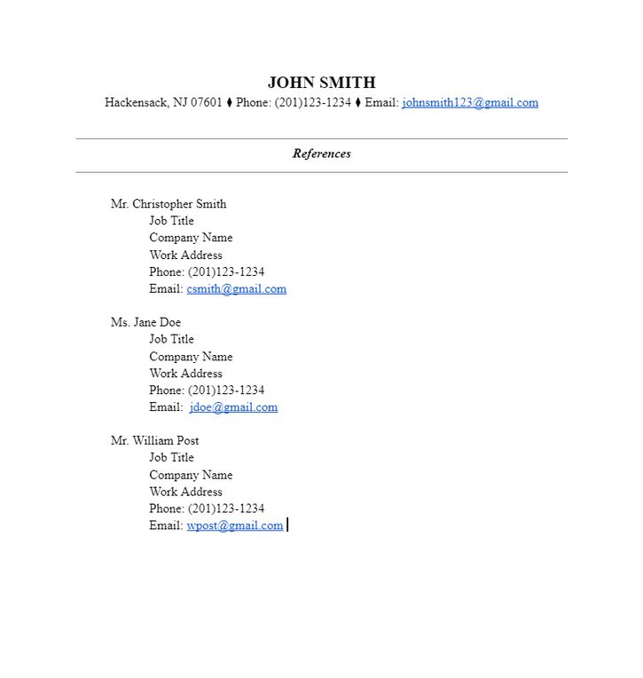
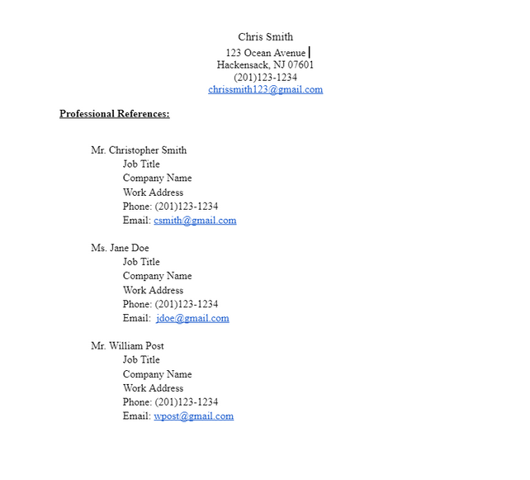
REFERENCES
Employers will ask you for references if they need them. Typically, they will ask for 2-3 references and/or have you write them on the application

Slide 9


INTERVIEW
How to prepare for interview:
  Dress appropriately, be on time
  Research company
      Look at their website
  Come up with examples of when you demonstrated a skill listed on resume
  Don't be afraid to ask questions politely about advancements or starting wage
  Follow instructions
      Ex. Hard copy of resume

Slide 10

INTERVIEW
  If interested in obtaining a license, ask about apprenticeship opportunities
  Have a definite understanding about what the employer will require of you before you accept the job
  Be businesslike and brief
  Stress your qualifications and interest
Notes:
EX. when do you feel you went above and beyond your job description

Slide 11
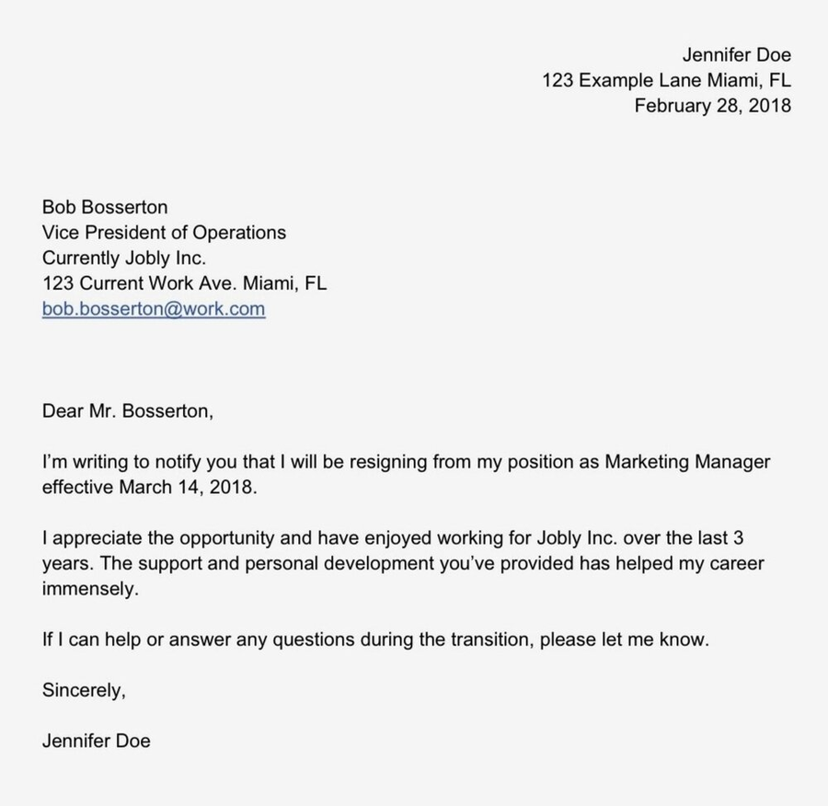
LEAVING A JOB
  Once you accept an offer, give proper notice
    2 weeks; letter of resignation
    Talk about starting time frame with new employer
  Don't burn bridges

